Slide 1
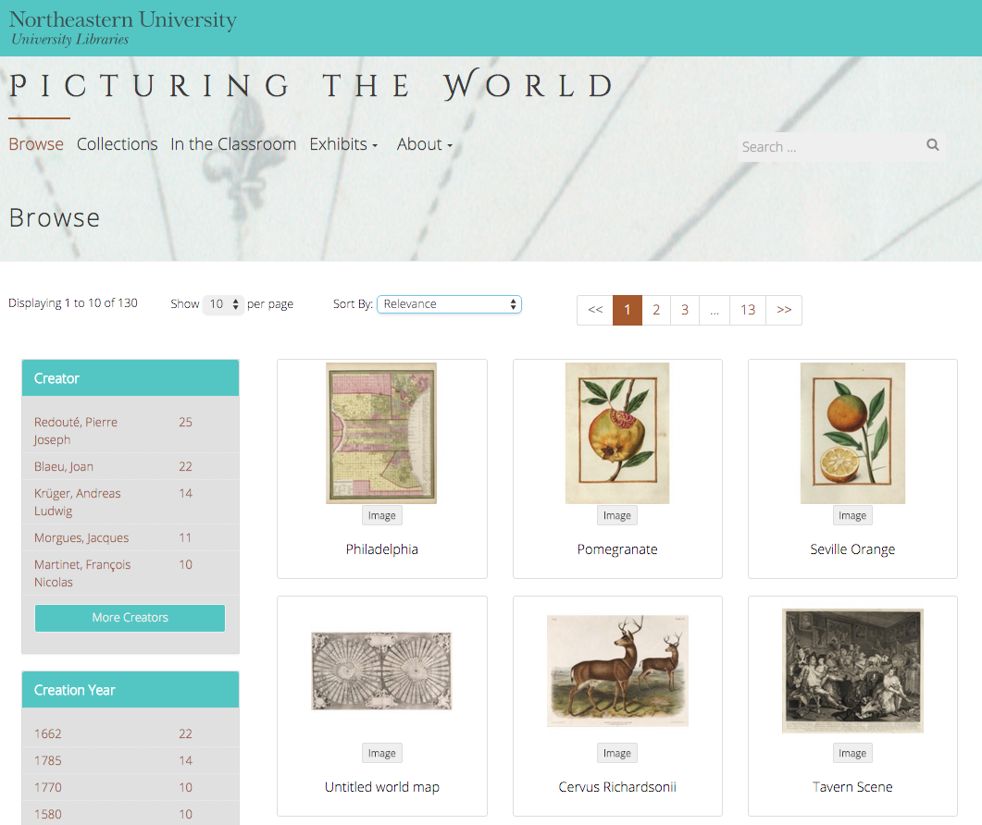
The DRS Project Toolkit
Sarah Sweeney
Digital Repository Manager
Northeastern University Libraries
Notes:
Promotional Slide

Slide 2
Ceres: Exhibits
Sarah Sweeney
Digital Repository Manager
Northeastern University Libraries
Notes:
Promotional Slide

Slide 3
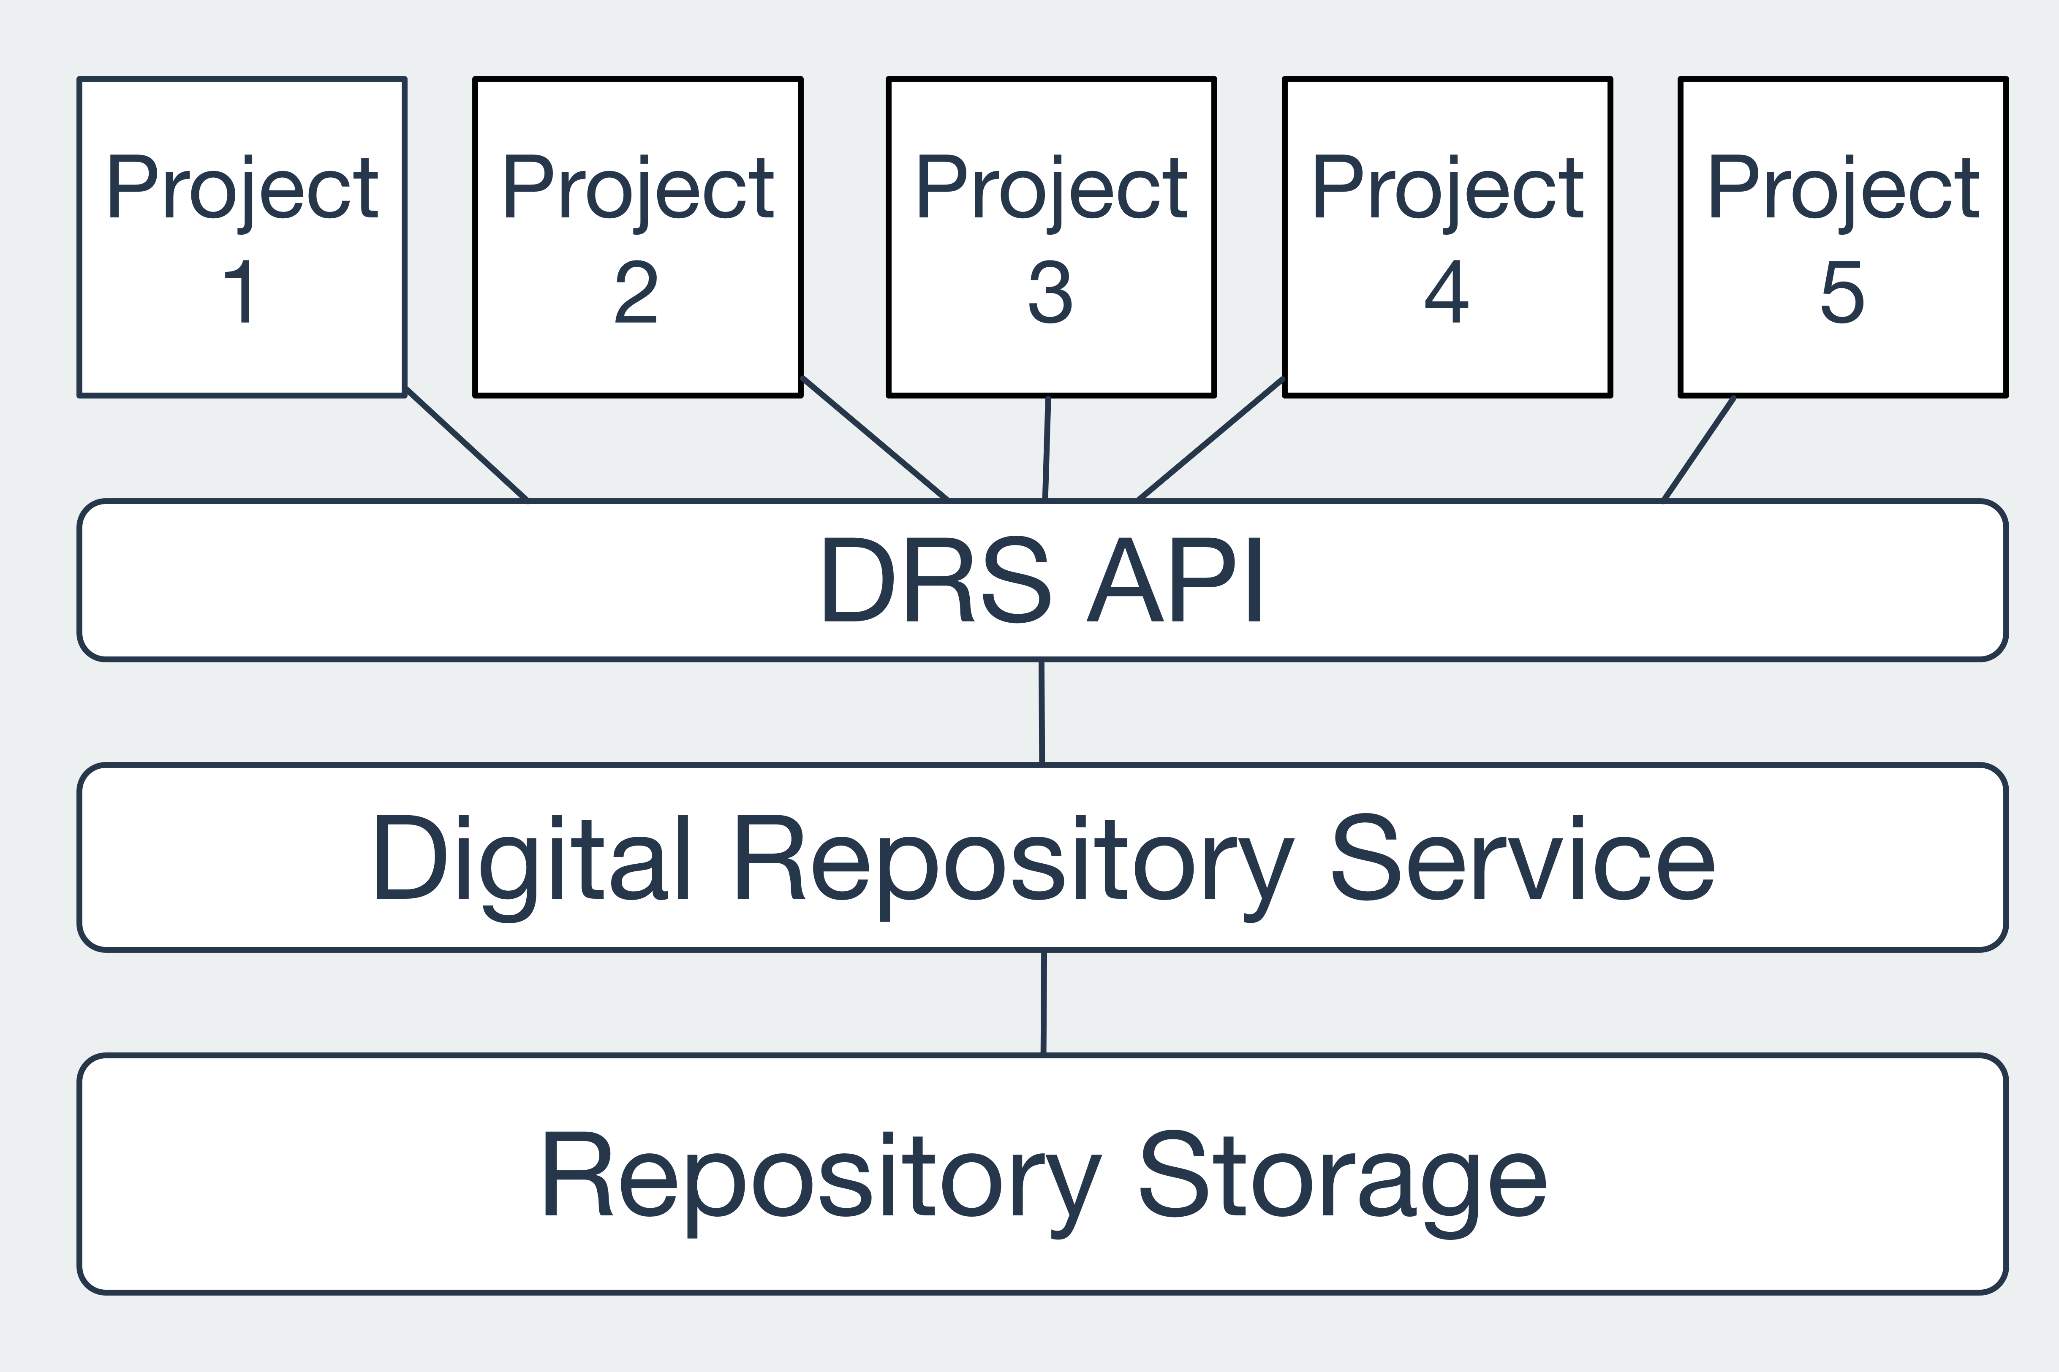
Toolkit Architecture

Slide 4
Toolkit Features
Faceted searching
Collection and file browsing
File downloading
Galleries
Playlists
Maps
Timelines

Slide 5
Toolkit Sites
Live Sites: [bitly/google url?]
Interviews with Jewish Latin American Writers and Artists
http://latinjewisharts.northeastern.edu
Picturing the World Gallery
http://arader.library.northeastern.edu
A Proud Past: A History of Boston-Bouvé College, 1913-1981
http://aproudpast.library.northeastern.edu
In Development
The Catskills Institute
Holocaust Awareness Week Programming
Spectrum Literary Magazine
DMC Studios Student Work Showcase
United South End Settlements
New Projects Projected for 2016
Dominican Prayer Book
The Civil Rights and Restorative Justice Project
The Early Black Boston Digital Almanac
The Early Caribbean Digital Archive
African American Institute Archives
Thoreau’s Journal Drawings

Slide 6
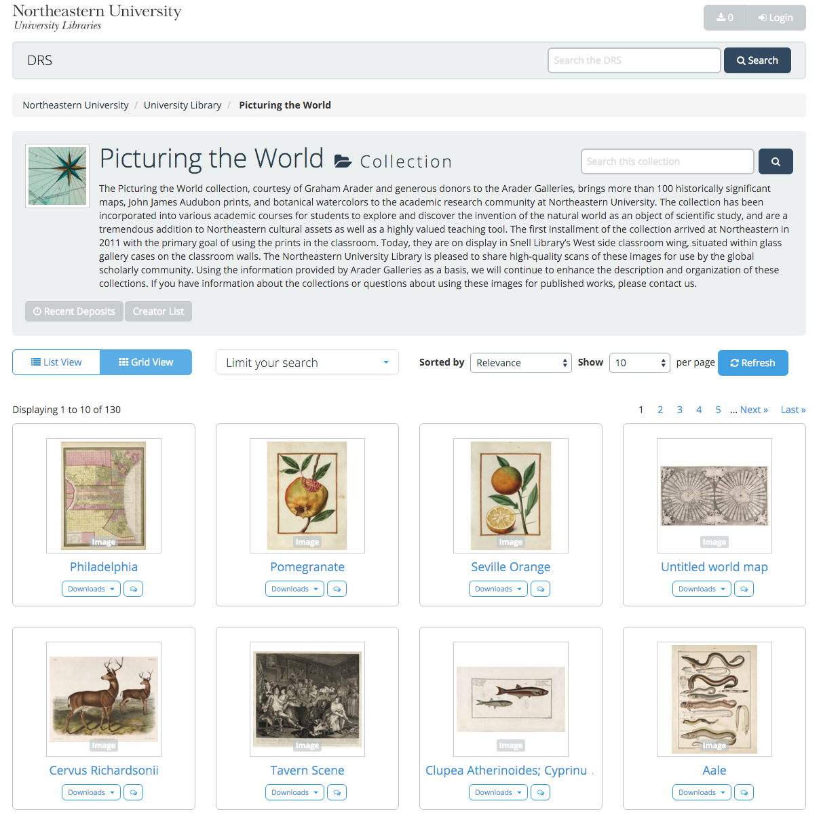
Digital Repository Service
DRS Project Toolkit

Slide 7

DSG
Resources
Contact
https://dsg.northeastern.edu
[toolkit url]
sj.sweeney@neu.edu
Sarah Sweeney
Digital Repository Manager
Northeastern University Library
repository.library.northeastern.edu
Notes:
Promotional Slide

